Slide 1
Distributed Systems Design COMP 6231
Communication
Lecture 5
Essam Mansour

Slide 2
Today…
Last Session:
Basic networking model
Layered Protocols
Today’s Session (Chapter 4.2, …,):
Middleware Layers
Announcement:
Midterm exam is on Monday Feb 15 at 11:45 pm

Slide 3

Middleware Layers
Applications, Services
Remote Invocation
Middleware Layers
IPC Primitives (e.g., Sockets)
Transport Layer (TCP/UDP)
Network Layer (IP)
Data-Link Layer
Physical Layer
Notes:
- In practice, the focus is on masking crash and omission failures
Add a slide prior to this slide with an animated example to make your point clear.

Slide 4
Remote Invocation
Remote invocation enables an entity to call a procedure that typically executes on an another computer without the programmer explicitly coding the details of communication
The underlying middleware will take care of raw-communication
Programmer can transparently communicate with remote entity
We will study two types of remote invocations:
Remote Procedure Calls (RPC)
Remote Method Invocation (RMI)

Slide 5
Remote Procedure Calls (RPC)
RPC enables a sender to communicate with a receiver using a simple procedure call
No communication or message-passing is visible to the programmer
Basic RPC Approach:
Machine A – Client
Machine B – Server
Client Program
Communication Module
Communication Module
Server Procedure
Request
int add(int x, int y) {
return x+y;
}
…
add(a,b);
…
Response
Client process
Server process
Client Stub
Server Stub (Skeleton)
Notes:
Basic RPC Set-up
The actual implementation of the procedure is in the server’s address space
A server starts a skeleton process that waits for client requests for the procedure call
A client stub, which has the same signature of the server procedure, is inserted into the client’s address space
During the remote procedure call:
A callee program calls the client stub
The client stub communicates over the network to the server skeleton
The server skeleton calls the procedure
The client stub returns back to the callee

Slide 6
Client Stub
The client stub:
Gets invoked by user code as a local procedure
Packs (or serializes or marshals) parameters into a request packet (say, request-pkt)
Invokes a client side transport routine (e.g., makerpc(request-pkt, &reply-pkt))
Unpacks (or de-serializes or unmarshals) reply-pkt into output parameters
Returns to user code

Slide 7
Server Stub
The server stub:
Gets invoked after a server side transport routine (e.g., getrequest()) is returned
Unmarshals arguments, de-multiplexes opcode, and invokes local server code
Marshals arguments, invokes a server-side transport routine (e.g., sendresponse()), and returns to server loop
E.g., Typical server main loop:
while (1) {
get-request (&p); /* blocking call */
execute-request (p); /* demux based on opcode */
}

Slide 8
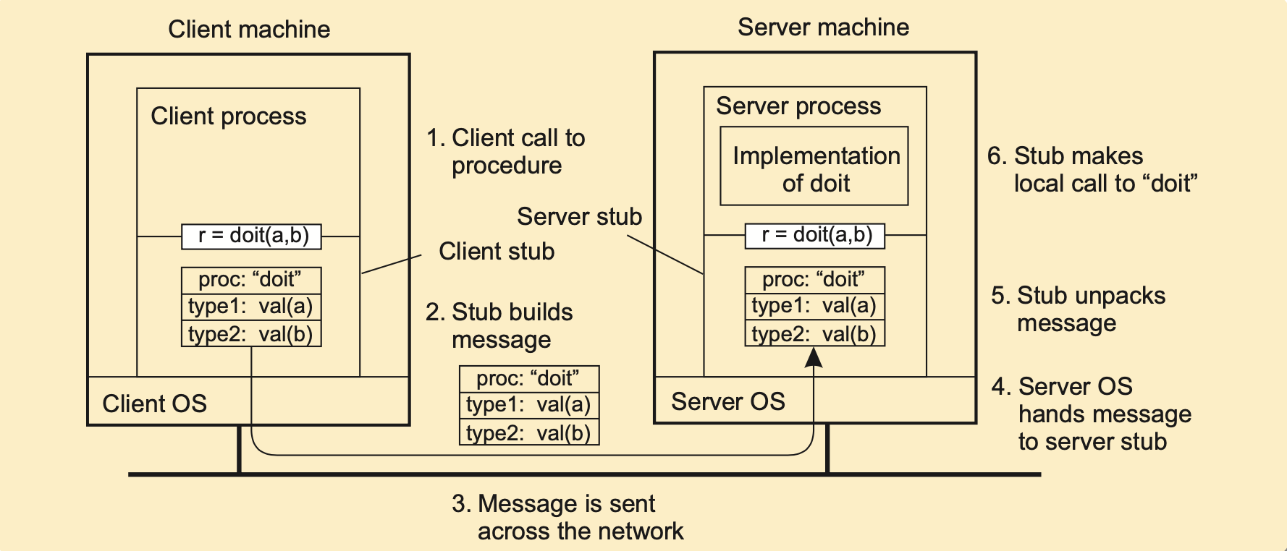
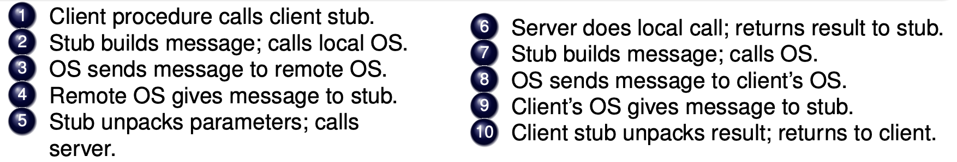
Basic RPC operation

Slide 9
RPC: Parameter Passing
There’s more than just wrapping parameters into a message
Client and server machines may have different data representations (think of byte ordering)
Wrapping a parameter means transforming a value into a sequence of bytes
Client and server have to agree on the same encoding:
How are basic data values represented (integers, floats, characters)
How are complex data values represented (arrays, unions)
Conclusion
Client and server need to properly interpret messages, transforming them into machine-dependent representations.
Notes:
- In practice, the focus is on masking crash and omission failures
Add a slide prior to this slide with an animated example to make your point clear.

Slide 10
Challenges in RPC
Parameter passing via marshaling
Procedure parameters and results have to be transferred over the network as bits
Data representation
Data representation has to be uniform
Architecture of the sender and receiver machines may differ
Failure Independence
Client and server might fail independently

Slide 11
Challenges in RPC
Parameter passing via marshaling
Procedure parameters and results have to be transferred over the network as bits
Data representation
Data representation has to be uniform
Architecture of the sender and receiver machines may differ
Failure Independence
Client and server might fail independently

Slide 12
Parameter Passing via Marshaling
Packing parameters into a message that will be transmitted over the network is called parameter marshalling
The parameters to the procedure and the result have to be marshaled before transmitting them over the network
Two types of parameters can be passed:
Value parameters
Reference parameters

Slide 13
1. Passing Value Parameters
Value parameters have complete information about the variable, and can be directly encoded into the message
E.g., integer, float, character
Values are passed through call-by-value
The changes made by the callee procedure are not reflected in the caller procedure

Slide 14
2. Passing Reference Parameters
Passing reference parameters like value parameters in RPC leads to incorrect results due to two reasons:
Invalidity of reference parameters at the server
Reference parameters are valid only within client’s address space
Solution: Pass the reference parameter by copying the data that is referenced
Changes to reference parameters are not reflected back at the client
Solution: “Copy/Restore” the data
Copy the data that is referenced by the parameter
Copy-back the value at server to the client

Slide 15
Challenges in RPC
Parameter passing via marshaling
Procedure parameters and results have to be transferred over the network as bits
Data representation
Data representation has to be uniform
Architecture of the sender and receiver machines may differ
Failure Independence
Client and server might fail independently

Slide 16
Data Representation
Computers in DSs often have different architectures and operating systems
The size of the data-type differ
E.g., A long data-type is 4-bytes in 32-bit Unix, while it is 8-bytes in 64-bit Unix systems
The format in which the data is stored differ
E.g., Intel stores data in little-endian format, while SPARC stores in big-endian format

Slide 17
Data Representation
Computers in DSs often have different architectures and operating systems
The size of the data-type differ
E.g., A long data-type is 4-bytes in 32-bit Unix, while it is 8-bytes in 64-bit Unix systems
The format in which the data is stored differ
E.g., Intel stores data in little-endian format, while SPARC stores in big-endian format
The client and server have to agree on how simple data is represented in the message
E.g., Format and size of data-types such as integer, char and float

Slide 18
Challenges in RPC
Parameter passing via marshaling
Procedure parameters and results have to be transferred over the network as bits
Data representation
Data representation has to be uniform
Architecture of the sender and receiver machines may differ
Failure Independence
Client and server might fail independently

Slide 19
Failure Independence
In the local case, the client and server live or die together
In the remote case, the client sees new failure types
Network failure
Server machine crash
Server process crash
Thus, failure handling code has to be more thorough (and essentially more complex)

Slide 20
Remote Procedure Call Types
Remote procedure calls can be:
Synchronous
Asynchronous (or Deferred Synchronous)

Slide 21
Synchronous vs. Asynchronous RPCs
An RPC with strict request-reply blocks the client until the server returns
Blocking wastes resources at the client
Asynchronous RPCs are used if the client does not need the result from server
The server immediately sends an ACK back to the client
The client continues the execution after an ACK from the server
Client
wait for result
client
wait for acceptance
return from call
call remote procedure
return from call
call remote procedure
request
reply
request
accept request
Server
server
call local procedure and return results
call local procedure
time
time
Synchronous RPCs
Asynchronous RPCs
Notes:
Asynchronous RPCs are useful in scenarios where
the server execution is immaterial to the client
when the procedure returns no result

Slide 22
Deferred Synchronous RPCs
Asynchronous RPC is also useful when a client wants the results, but does not want to be blocked until the call finishes
Client uses deferred synchronous RPCs
Single request-response RPC is split into two RPCs
First, client triggers an asynchronous RPC on server
Second, on completion, server calls-back client to deliver the results
client
wait for acceptance
interrupt client
call remote procedure
return from call
return results
acknowledge
request
accept request
server
call local procedure
time
call client with asynchronous RPC

Slide 23
Remote Method Invocation (RMI)
RMI is similar to RPC, but in a world of distributed objects
The programmer can use the full expressive power of object-oriented programming
RMI not only allows to pass value parameters, but also pass object references
In RMI, a calling object can invoke a method on a potentially remote object

Slide 24
Remote Objects and Supporting Modules
In RMI, objects whose methods can be invoked remotely are known as “remote objects”
Remote objects implement remote interfaces
During any method call, the system has to resolve whether the method is being called on a local or a remote object
Local calls should be called on a local object
Remote calls should be called via remote method invocation
Remote Reference Module is responsible for translating between local and remote object references

Slide 25
RMI Control Flow
Machine A – Client
Machine B – Server
Communication Module
Communication Module
Skeleton and Dispatcher for B’s class
Proxy for B
Request
Obj A
Remote Obj B
Remote Reference Module
Response
Remote Reference Module

Slide 26
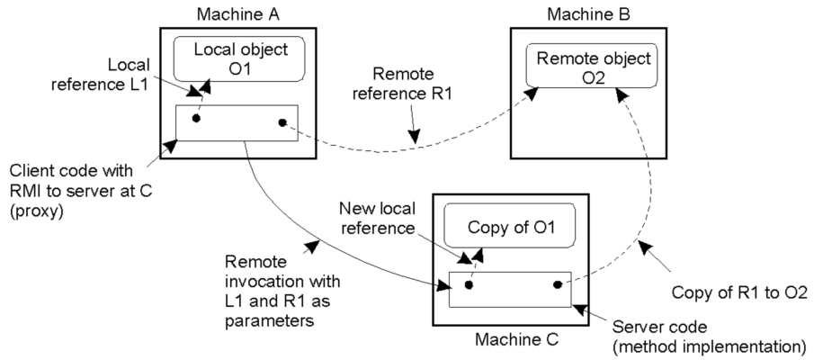
Parameter Passing
· Less restrictive than RPCs
– Supports system-wide object references
– [Java] pass local objects by value, pass remote objects by reference
– [Java] does serialization of local object parameters

Slide 27
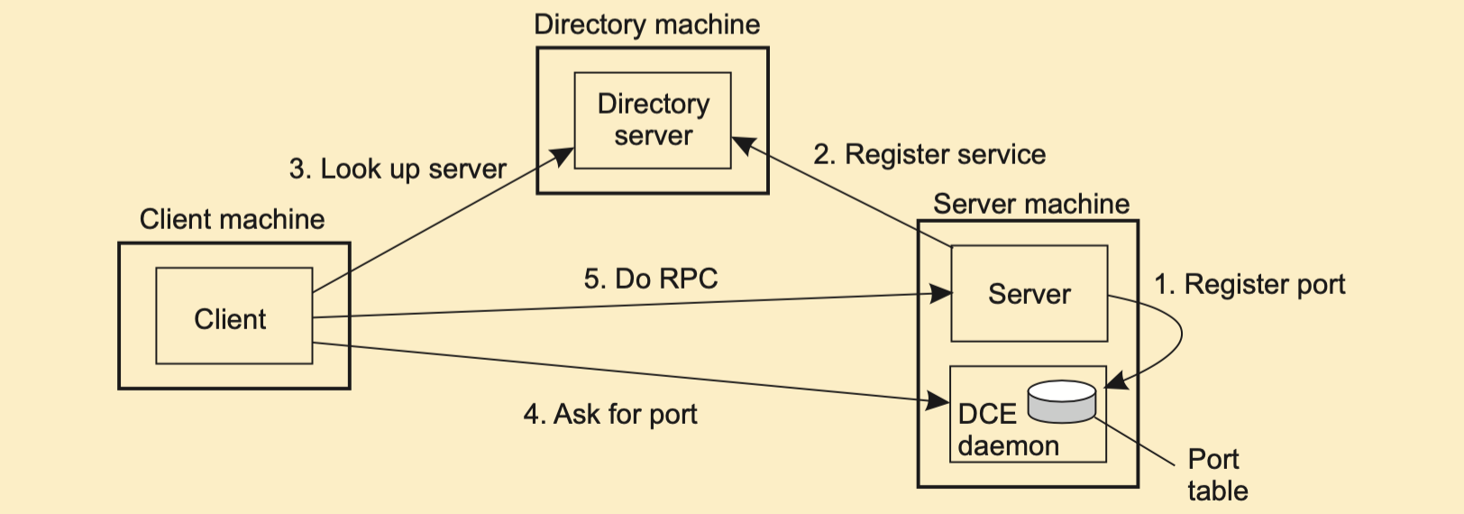
﻿Distributed Computing Environment (DCE) Client-to-server binding
(1) Client must locate server machine, and (2) locate the server.

Slide 28
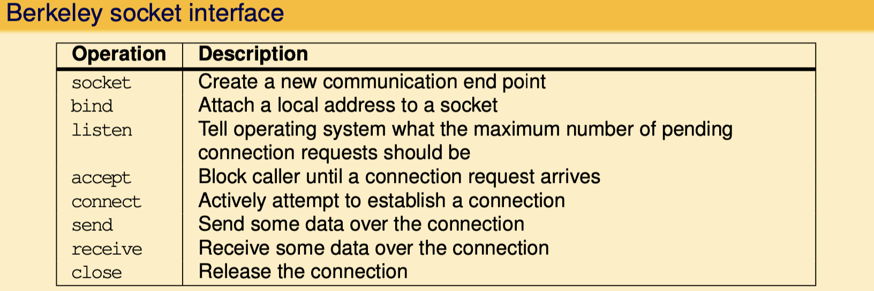
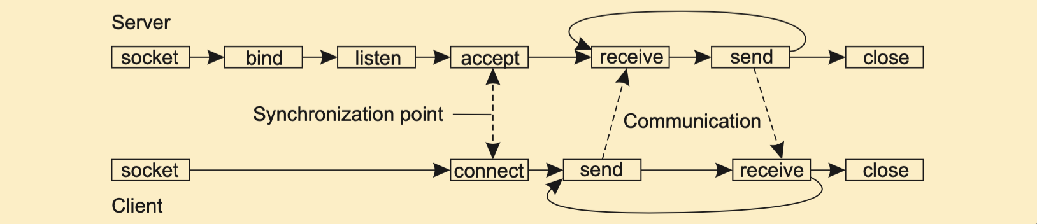
Transient messaging: sockets

Slide 29
Making sockets easier to work with
Observation
Sockets are rather low level and programming mistakes are easily made. However, the way that they are used is often the same (such as in a client-server setting).
Alternative: ZeroMQ
Provides a higher level of expression by pairing sockets: one for sending messages at process P and a corresponding one at process Q for receiving messages. All communication is asynchronous.
Three patterns
Request-reply
Publish-subscribe
Pipeline
Notes:
- In practice, the focus is on masking crash and omission failures
Add a slide prior to this slide with an animated example to make your point clear.

Slide 30
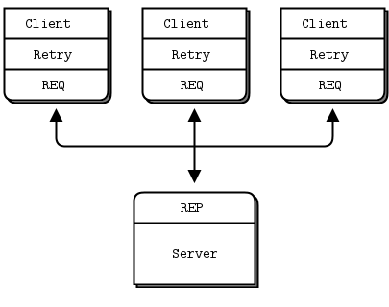
Message-oriented communication Request-reply
Notes:
- In practice, the focus is on masking crash and omission failures
Add a slide prior to this slide with an animated example to make your point clear.

Slide 31
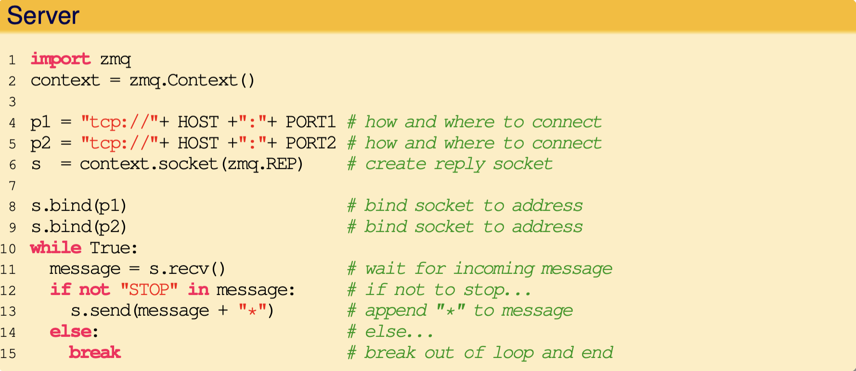
Message-oriented communication Request-reply
Notes:
- In practice, the focus is on masking crash and omission failures
Add a slide prior to this slide with an animated example to make your point clear.

Slide 32
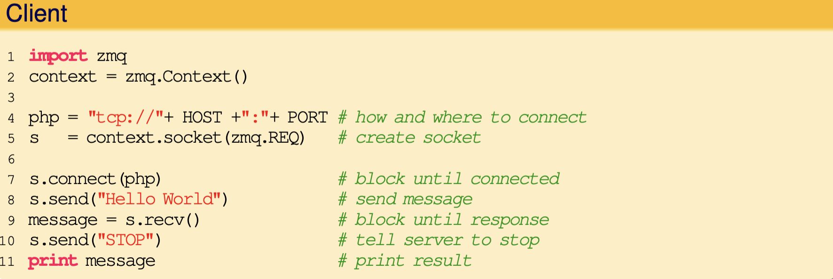
Message-oriented communication Request-reply
Notes:
- In practice, the focus is on masking crash and omission failures
Add a slide prior to this slide with an animated example to make your point clear.

Slide 33
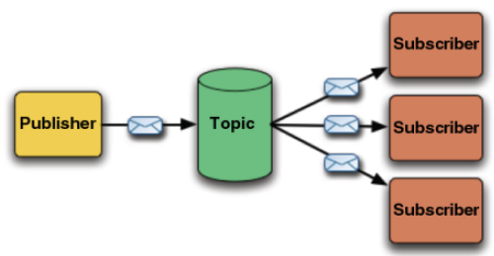
Message-oriented communication Publish-subscribe
Notes:
- In practice, the focus is on masking crash and omission failures
Add a slide prior to this slide with an animated example to make your point clear.

Slide 34
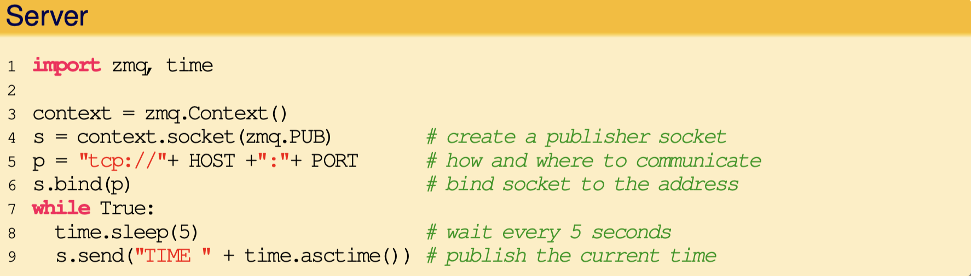
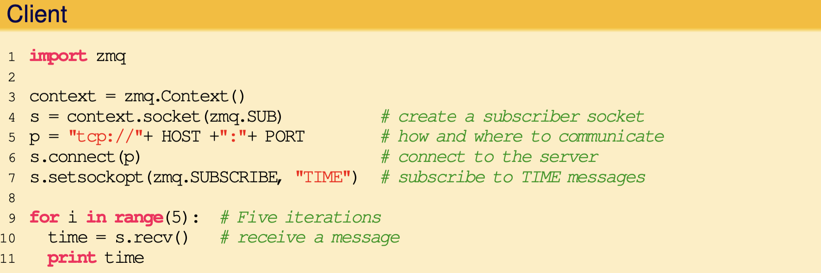
Message-oriented communication Publish-subscribe
Notes:
- In practice, the focus is on masking crash and omission failures
Add a slide prior to this slide with an animated example to make your point clear.

Slide 35
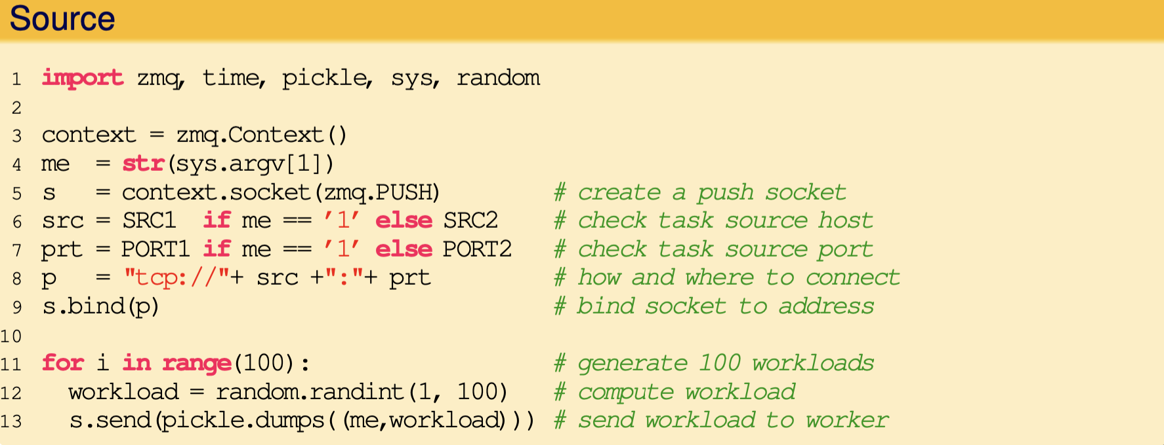
Message-oriented communication Pipeline
Notes:
- In practice, the focus is on masking crash and omission failures
Add a slide prior to this slide with an animated example to make your point clear.

Slide 36
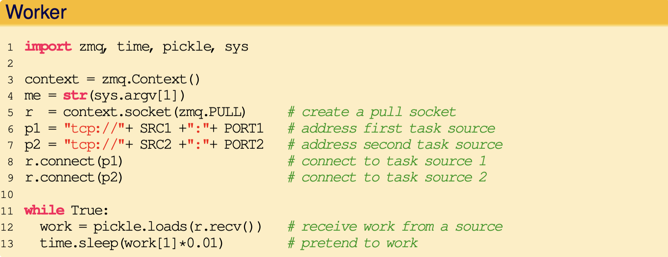
Message-oriented communication Pipeline
Notes:
- In practice, the focus is on masking crash and omission failures
Add a slide prior to this slide with an animated example to make your point clear.

Slide 37
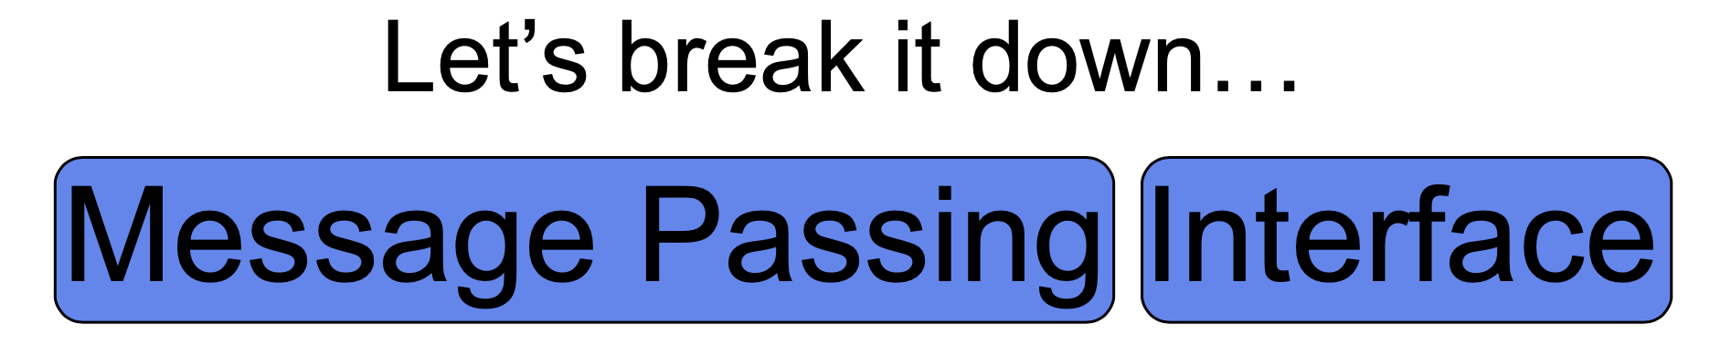
MPI: When lots of flexibility is needed
Notes:
- In practice, the focus is on masking crash and omission failures
Add a slide prior to this slide with an animated example to make your point clear.

Slide 38
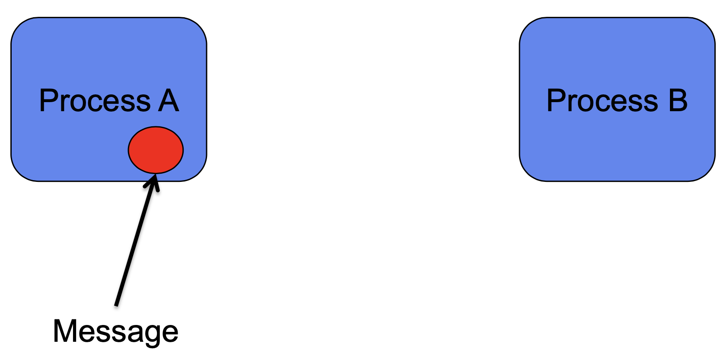
MPI: When lots of flexibility is needed
Notes:
- In practice, the focus is on masking crash and omission failures
Add a slide prior to this slide with an animated example to make your point clear.

Slide 39
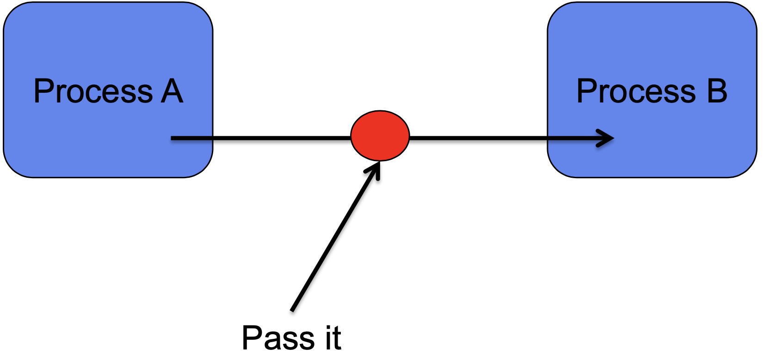
MPI: When lots of flexibility is needed
Notes:
- In practice, the focus is on masking crash and omission failures
Add a slide prior to this slide with an animated example to make your point clear.

Slide 40
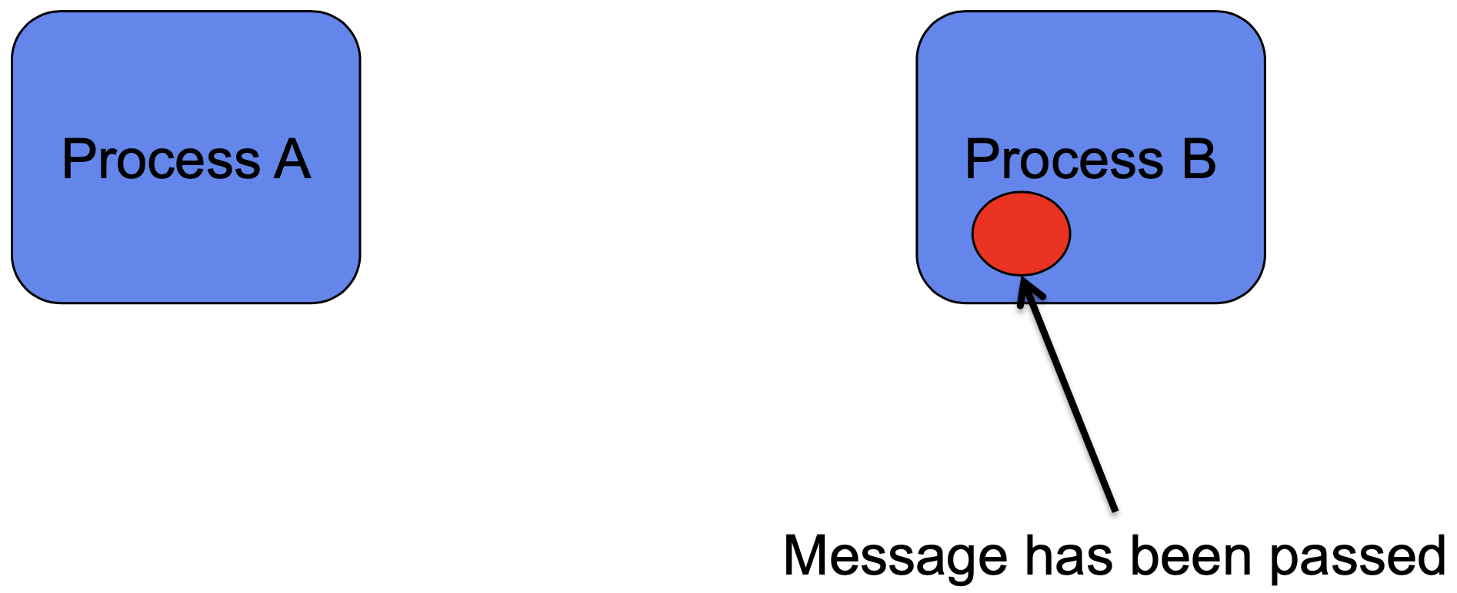
MPI: When lots of flexibility is needed
Notes:
- In practice, the focus is on masking crash and omission failures
Add a slide prior to this slide with an animated example to make your point clear.

Slide 41

MPI: When lots of flexibility is needed
Notes:
- In practice, the focus is on masking crash and omission failures
Add a slide prior to this slide with an animated example to make your point clear.

Slide 42
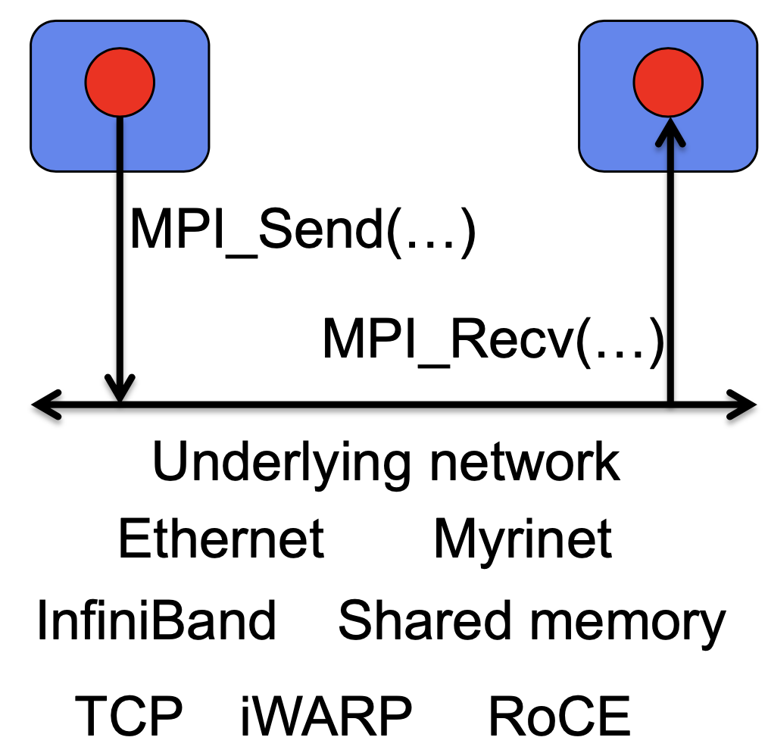
MPI: When lots of flexibility is needed
Notes:
- In practice, the focus is on masking crash and omission failures
Add a slide prior to this slide with an animated example to make your point clear.

Slide 43
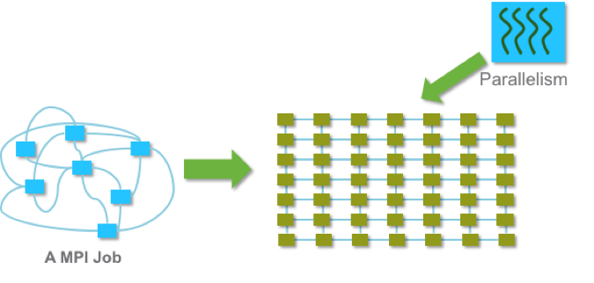
MPI and HPC
Notes:
- In practice, the focus is on masking crash and omission failures
Add a slide prior to this slide with an animated example to make your point clear.

Slide 44
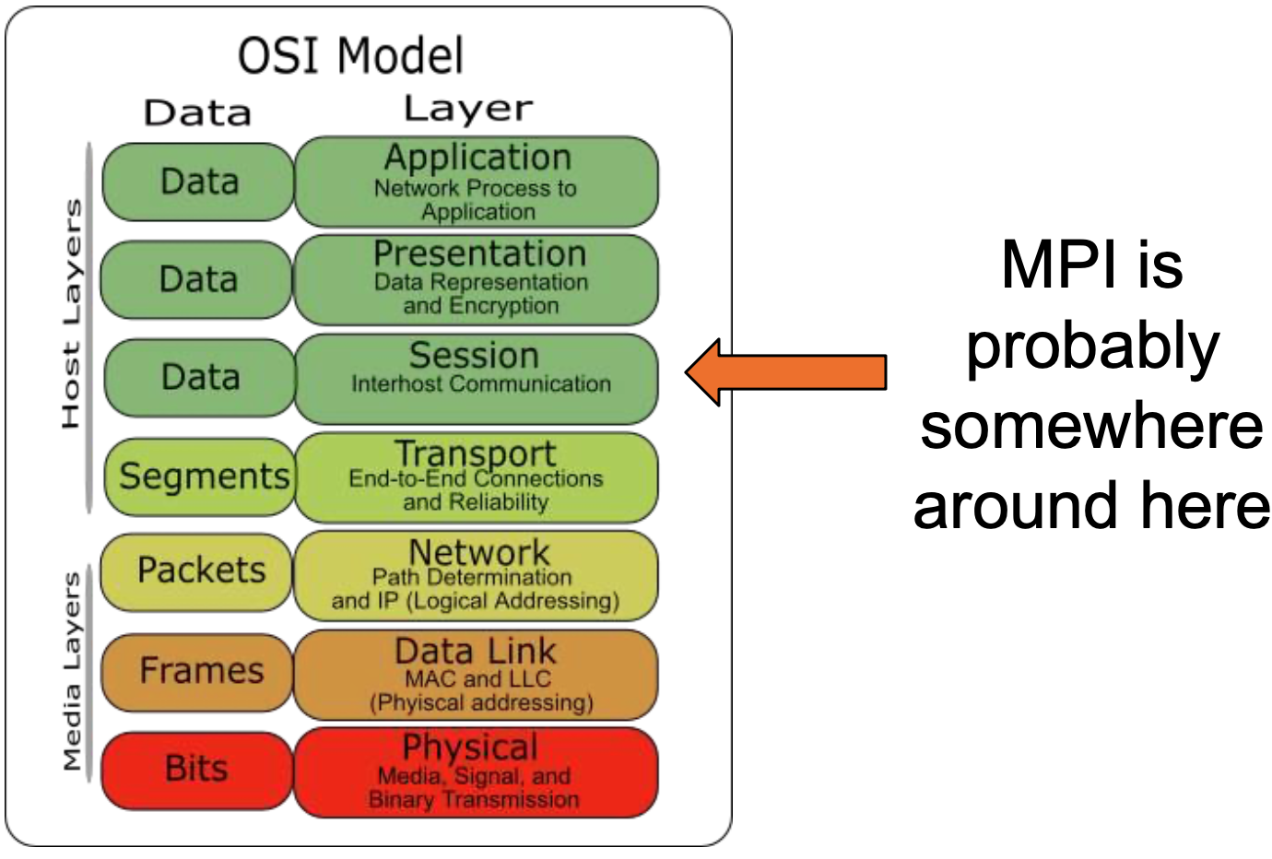
MPI: When lots of flexibility is needed
Notes:
- In practice, the focus is on masking crash and omission failures
Add a slide prior to this slide with an animated example to make your point clear.

Slide 45
MPI Basics
• “6 function MPI” ▪ MPI_Init(): startup ▪ MPI_Comm_size(): how many peers? ▪ MPI_Comm_rank(): my unique (ordered) ID
▪ MPI_Send(): send a message ▪ MPI_Recv(): receive a message ▪ MPI_Finalize(): shutdown
• Can implement a huge number of parallel applications with just these 6 functions
Notes:
- In practice, the focus is on masking crash and omission failures
Add a slide prior to this slide with an animated example to make your point clear.

Slide 46
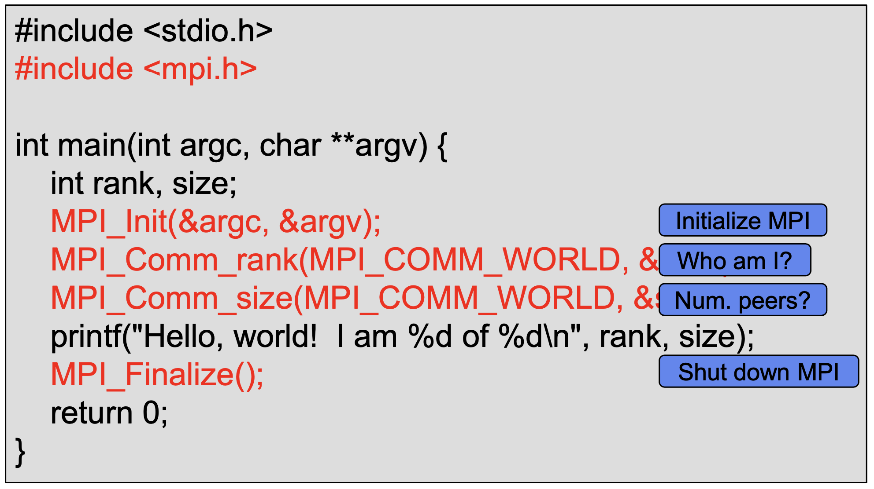
MPI Basics
Notes:
- In practice, the focus is on masking crash and omission failures
Add a slide prior to this slide with an animated example to make your point clear.

Slide 47
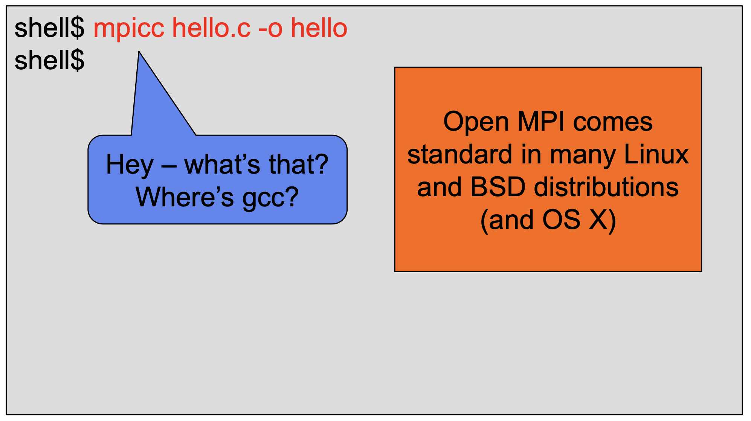
MPI Basics
Notes:
- In practice, the focus is on masking crash and omission failures
Add a slide prior to this slide with an animated example to make your point clear.

Slide 48
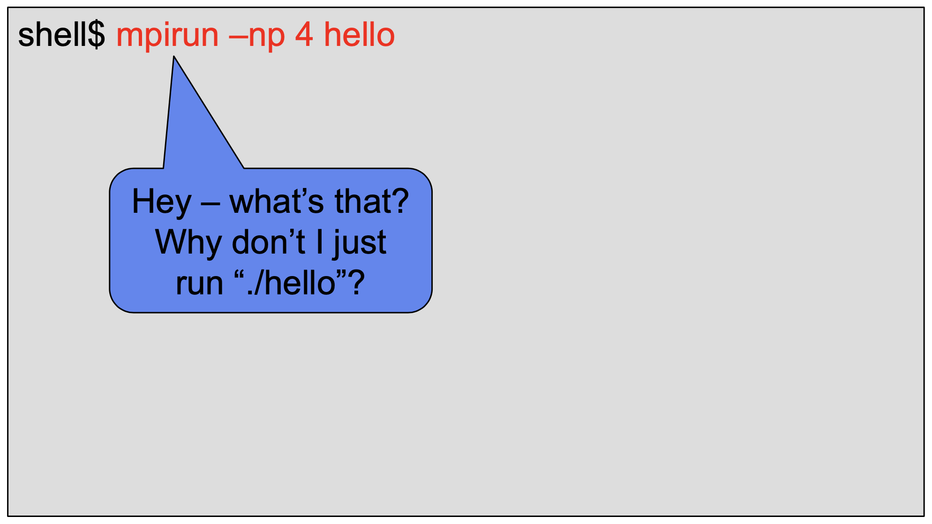
MPI Basics
Notes:
- In practice, the focus is on masking crash and omission failures
Add a slide prior to this slide with an animated example to make your point clear.

Slide 49
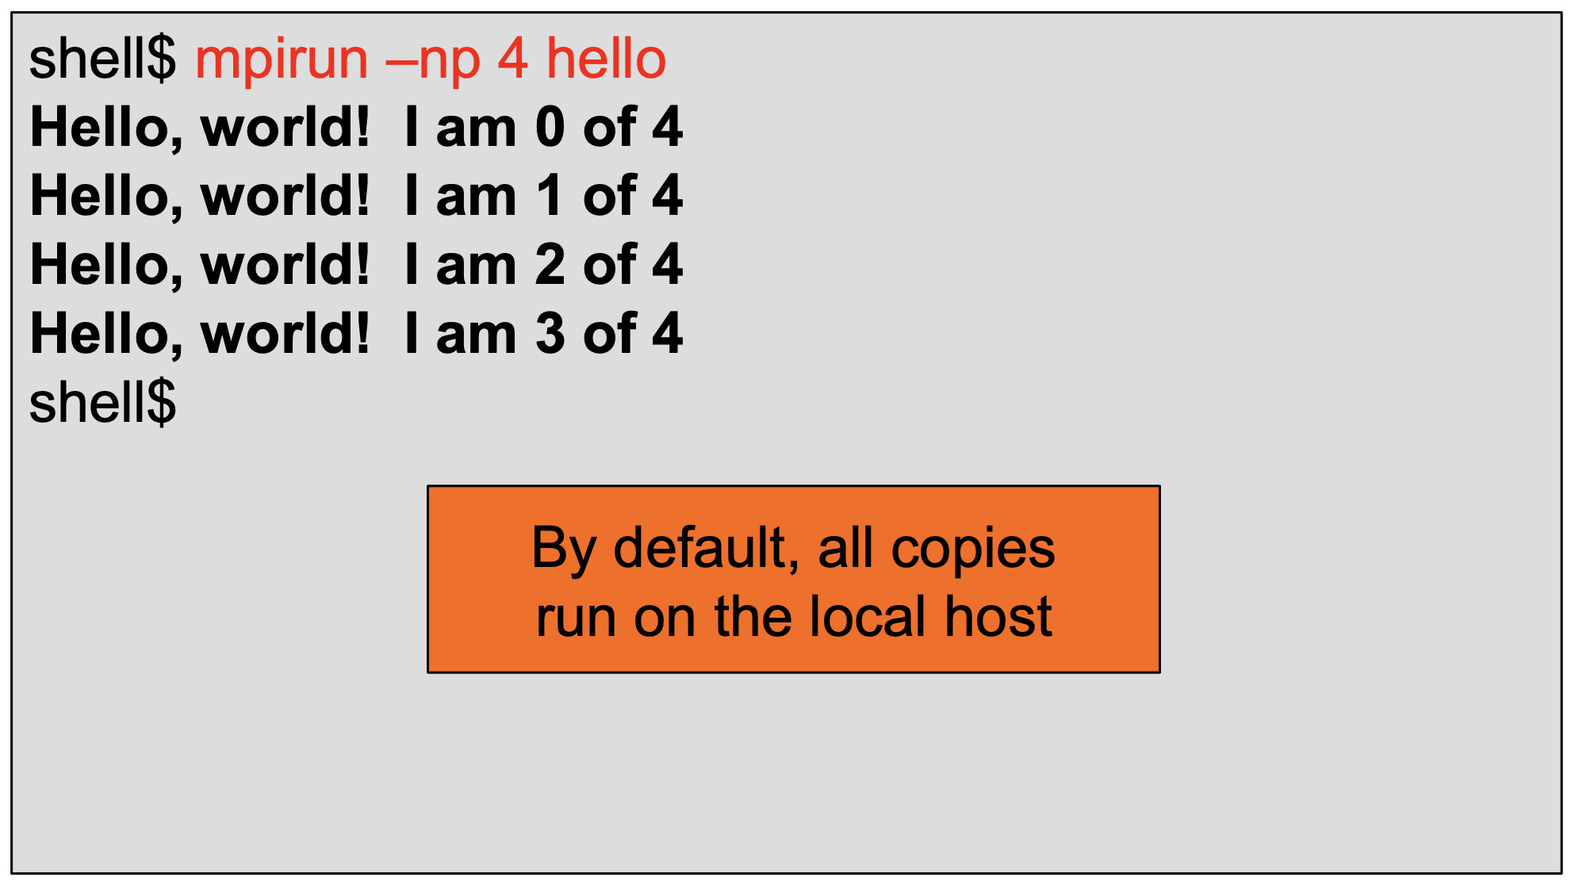
MPI Basics
Notes:
- In practice, the focus is on masking crash and omission failures
Add a slide prior to this slide with an animated example to make your point clear.

Slide 50
Message-Queuing Model
Queue managers
Queues are managed by queue managers. An application can put messages only into a local queue. Getting a message is possible by extracting it from a local queue only ⇒ queue managers need to route messages.
Notes:
- In practice, the focus is on masking crash and omission failures
Add a slide prior to this slide with an animated example to make your point clear.

Slide 51
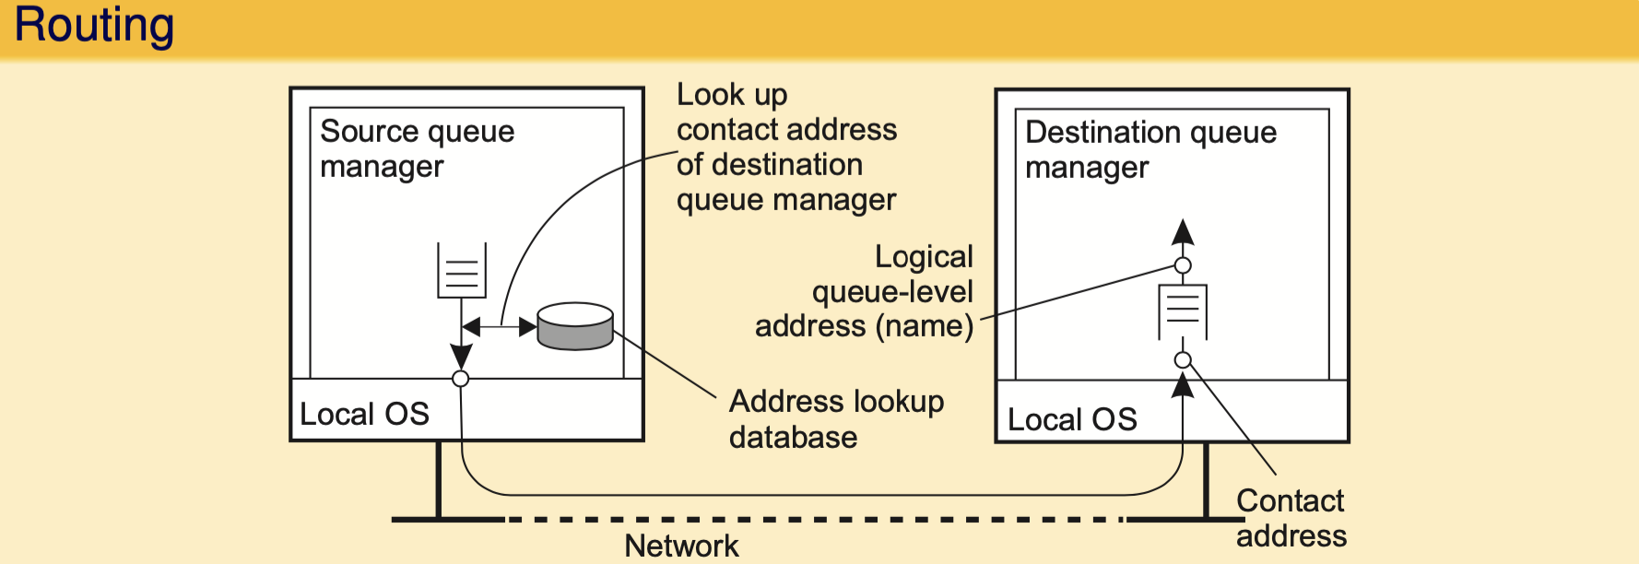
Message-Queuing Model
Primitive | Meaning
Put | Append a message to a specified queue
Get | Block until the specified queue is nonempty, and remove the first message
Poll | Check a specified queue for messages, and remove the first. Never block.
Notify | Install a handler to be called when a message is put into the specified queue.
Notes:
- In practice, the focus is on masking crash and omission failures
Add a slide prior to this slide with an animated example to make your point clear.

Slide 52
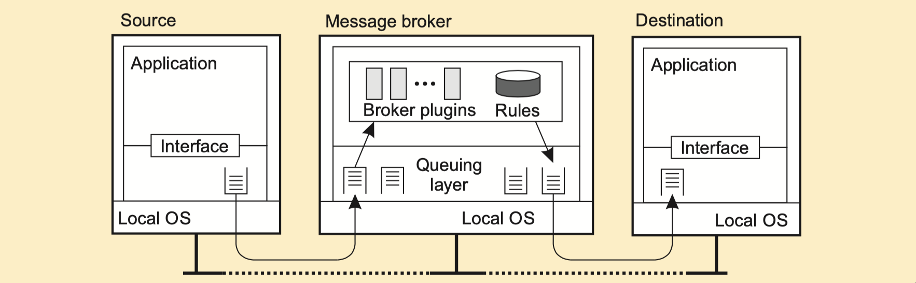
Message broker: general architecture
Message broker: application level gateway in MQS
Convert incoming messages so that they can be understood by destination (format conversion)
Also used for pub-sub systems
Notes:
- In practice, the focus is on masking crash and omission failures
Add a slide prior to this slide with an animated example to make your point clear.

Slide 53
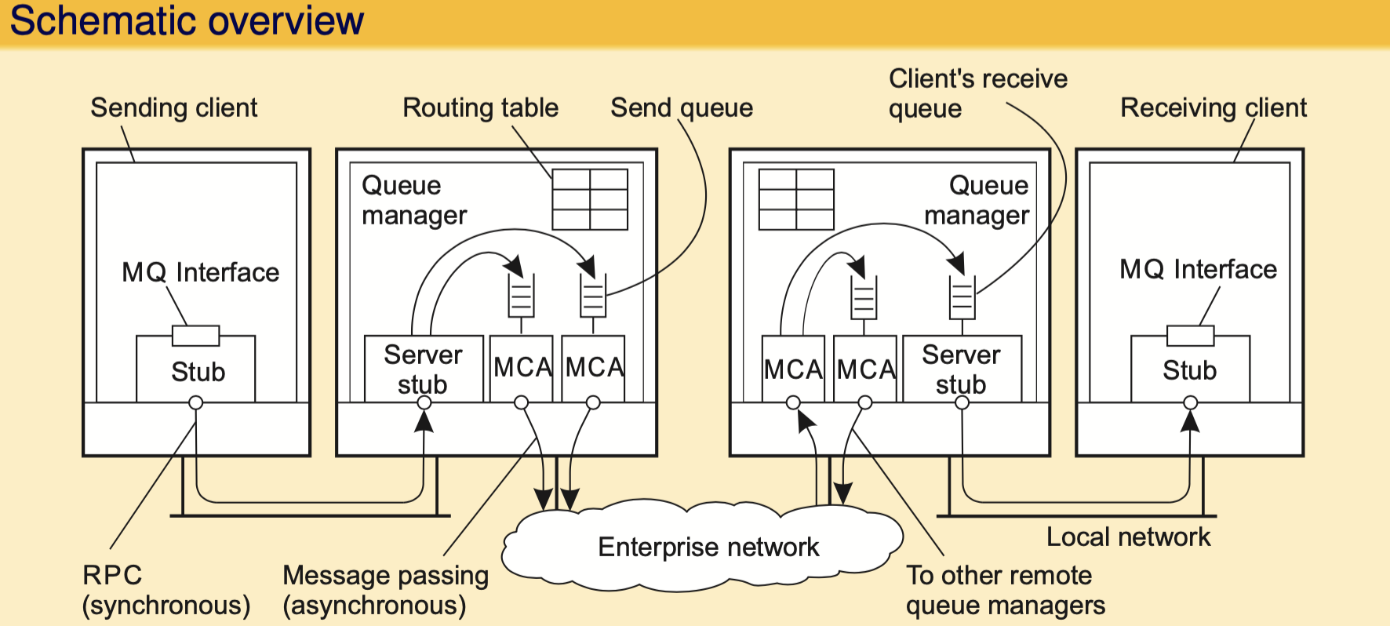
IBM’s WebSphere MQ
Queue managers manage queues
Connected through message channels
Message channel agent (MCA)
Checks queue, wraps into TCP packet, send to receiving MCA
Notes:
- In practice, the focus is on masking crash and omission failures
Add a slide prior to this slide with an animated example to make your point clear.

Slide 54
IBM’s WebSphere MQ
Basic concepts
It sends messages across networks of diverse components.
Application-specific messages are put into, and removed from queues
Queues reside under the regime of a queue manager
Processes can put messages only in local queues, or through an RPC mechanism
Message transfer
Messages are transferred between queues
Message transfer between queues at different processes, requires a channel At each end point of channel is a message channel agent
Message channel agents are responsible for:
Setting up channels using lower-level network communication facilities (e.g., TCP/IP)
(Un)wrapping messages from/in transport-level packets
Sending/receiving packets
Notes:
- In practice, the focus is on masking crash and omission failures
Add a slide prior to this slide with an animated example to make your point clear.

Slide 55
IBM’s WebSphere MQ
Basic concepts
It sends messages across networks of diverse components.
Application-specific messages are put into, and removed from queues
Queues reside under the regime of a queue manager
Processes can put messages only in local queues, or through an RPC mechanism
Message transfer
Messages are transferred between queues
Message transfer between queues at different processes, requires a channel At each end point of channel is a message channel agent
Message channel agents are responsible for:
Setting up channels using lower-level network communication facilities (e.g., TCP/IP)
(Un)wrapping messages from/in transport-level packets
Sending/receiving packets
Notes:
- In practice, the focus is on masking crash and omission failures
Add a slide prior to this slide with an animated example to make your point clear.

Slide 56
A To-Do List
Read Chapter 4.1, 4.2 and 4.3
Section 4.4 is not part of the exam.
First midterm exam is on Monday Feb 15 at 11:45 pm

Slide 57
How not to Follow Your Dreams?
“Believe in:
overnight success,
someone else has the answers for you,
when growth is guaranteed you should settle down,
the fault is someone else’s, and
only goals themselves matter.
Believe me, you do that and you destroy your dream.”
[Bel Pesce in the Ted talk.]

